Slide 1
Informatics in emerging and re-emerging infectious diseases
Rashmitha Eri
Saketha Kusu

Slide 2
Contents
Definition
Factors
Impact of informatics on population and public health
Data collection methods
Challenges associated with this approach
Case studies
Opportunities for new areas of investigation
Conclusion

Slide 3
Definition
Emerging infectious diseases have either emerged within a population or have existed but are experiencing a notable increase in incidence or geographical spread.
Ex: Ebola virus, Zika virus infection, Corona virus
Re-emerging infectious diseases are those that were previously under control but have recently experienced a resurgence
Ex: Tuberculosis, Measles, Dengue fever, Cholera, Influenza

Slide 4
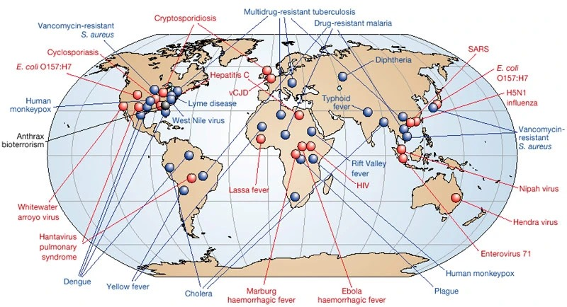
Red represents newly emerging diseases;
blue, re-emerging/resurging diseases;
black, a ‘deliberately emerging’ disease.

Slide 5
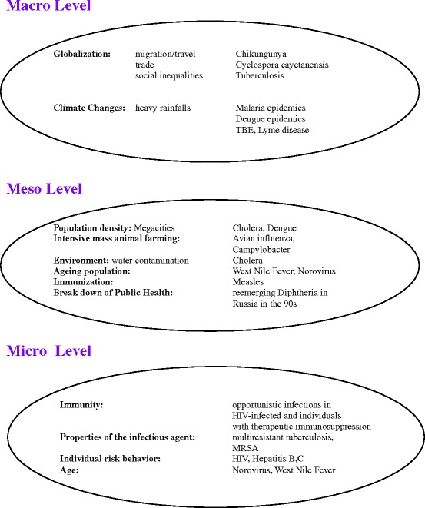
Factors contributing to the emergence of Infections Diseases

Slide 6
Impact of informatics on population and public health
Health informatics, which involves using technology to manage health information, has greatly benefited public health in various ways:
1. Collecting and Analyzing Data: It helps gather and understand large amounts of health-related data, like who gets sick and where allowing health officials to spot trends and issues faster.
2. Surveillance and Early Warnings: Health informatics sets up systems that watch for health problems in real-time, like outbreaks of diseases, letting us respond quickly to keep them from spreading.
3. Tracking Diseases: It helps track how diseases spread, which groups are at risk, and where resources are needed most to fight them effectively.
4. Developing Interventions and Policies: By looking at health data, we can figure out what actions and policies will improve public health, like vaccination programs or smoking bans.

Slide 7
5. Promoting Health and Educating People: Health informatics helps share health information widely, using websites, apps, and social media to teach people how to stay healthy and make better choices.
6. Supporting Doctors and Nurses: It provides tools to help healthcare providers make smart decisions about treatment and prevention, improving outcomes for patients.
7. Planning Resources: By analyzing data, health agencies can decide where to allocate resources like money and staff to tackle health problems effectively.

Slide 8
Data collection methods
Electronic Health Records (EHRs): Electronic health records contain patient health information collected during routine clinical encounters.
Laboratory Reports: Laboratory reports contain test results from diagnostic tests, such as blood tests, microbiological cultures, and molecular assays.
Digital Disease Surveillance: Digital disease surveillance involves monitoring online sources, such as news reports, social media posts, and internet search queries, for information related to disease outbreaks
Surveys and Questionnaires: Surveys and questionnaires collect self-reported data from individuals or populations on various health-related topics
Digital Contact Tracing: Digital contact tracing uses mobile phone applications, wearable devices, and other digital technologies to track and monitor individuals' movements and interactions.

Slide 9
Challenges
Data Quality and Availability: Limited access to good-quality data from different sources makes it hard to analyze and make decisions about disease surveillance.
Data Integration and Interoperability: Combining data from various sources with different formats and systems is difficult and can lead to problems with how the data work together.
Data Privacy and Security: Ensuring that sensitive health data stays private and secure while we use it for disease surveillance is a big challenge.
Grasping Disease Complexity: Trying to understand how new diseases spread is tricky because there are lots of things we don't know, like how they move from person to person or how they change over time.
Timeliness of Data Analysis: Sometimes, it takes too long to collect, process, and analyze the data, which can slow down our ability to respond quickly to new disease outbreaks.

Slide 10
How to overcome this challenges?
1. Better Collaboration: Working closely with different groups, like health agencies, doctors, researchers, and tech experts, to share information and help each other out.
2. Standardization and Compatibility: Making sure that different types of data can work together smoothly by using the same rules and systems.
3. Responsible Data Handling: Following strict rules to keep people's health information safe and only using it in the right way.
4. Building Up Resources: Training more people and getting better tools to help us keep track of diseases.
5. Using Smart Technology: Using advanced computer programs to quickly analyze lots of data and find patterns that tell us when new diseases might be spreading.
6. Real-Time Monitoring Systems: Setting up systems that can watch for diseases as they happen, like using apps on phones or special computer programs.
These strategies are meant to help us do a better job of keeping track of new diseases and responding to them faster.

Slide 11
Case Studies
1.Global Infectious Disease Surveillance and Case Tracking System for COVID-19: Development Study
Lee HA, Kung HH, Lee YJ, Chao JCJ, Udayasankaran JG, Fan HC, Ng KK, Chang YK, Kijsanayotin B, Marcelo AB, Hsu CY
JMIR Med Inform 2020;8(12):e20567
URL: https://medinform.jmir.org/2020/12/e20567
DOI: 10.2196/20567
A global COVID-19 surveillance system based on blockchain architecture facilitates real-time data exchange among physicians using the International Patient Summary (IPS). This system allows for daily IPS uploading and enhancement, enabling effective disease tracking and treatment optimization. The Infectious Disease Case Tracking module aids organizations like the Centers for Disease Control and Prevention in monitoring case movements. Overall, this system supports rapid response efforts, information retrieval, and international research collaboration in combating COVID-19 and other infectious diseases.
2.Improving Detection of Disease Re-emergence Using a Web-Based Tool (RED Alert): Design and Case Analysis Study
Parikh N, Daughton AR, Rosenberger WE, Aberle DJ, Chitanvis ME, Altherr FM, Velappan N, Fairchild G, Deshpande A
JMIR Public Health Surveill 2021;7(1):e24132
URL: https://publichealth.jmir.org/2021/1/e24132
DOI: 10.2196/24132
RED Alert, a novel online tool, aids public health officials in identifying the resurgence of diseases that were previously controlled. By analyzing data from diverse sources, including the World Health Organization, it tracks diseases like measles, cholera, dengue, and yellow fever to detect any re-emergence. While the tool is effective in spotting outbreaks, occasional errors occur. Nonetheless, it furnishes valuable insights into the reasons behind disease resurgence, empowering health professionals to intervene effectively. This tool marks a significant advancement in combating recurrent diseases.

Slide 12
Opportunities for New Areas of Investigation
Early Detection Algorithms: Employ machine learning algorithms to analyze incoming data in real-time, allowing for the early detection of outbreaks and unusual disease patterns.
Syndromic Surveillance: Implement syndromic surveillance techniques that monitor non-specific symptoms to detect emerging diseases before they are clinically diagnosed.
Data-driven Forecasting: Utilize historical disease data, environmental factors, and population dynamics to build predictive models that forecast disease outbreaks and guide resource allocation.
Mobile Health Technologies: Leverage mobile health technologies for remote symptom monitoring, contact tracing, and community-based surveillance, particularly in resource-limited settings.

Slide 13
Conclusion
Informatics holds immense potential for advancing our ability to understand, monitor, and respond to infectious diseases. By leveraging data-driven approaches and cutting-edge technology, we can work towards a healthier and more resilient future for all.

Slide 14
References
Löscher T, Prüfer-Krämer L. Emerging and Re-emerging Infectious Diseases. Modern Infectious Disease Epidemiology. 2009 Jul 28:39–67. doi: 10.1007/978-0-387-93835-6_3. PMCID: PMC7153742.
Mukherjee S. Emerging Infectious Diseases: Epidemiological Perspective. Indian J Dermatol. 2017 Sep-Oct;62(5):459-467. doi: 10.4103/ijd.IJD_379_17. PMID: 28979007; PMCID: PMC5618832.
Schlipköter, U. and Flahault, A., 2010. Communicable diseases: achievements and challenges for public health. Public Health Reviews, 32, pp.90-119.
277 - Multicenter Epidemiologic Study of Coronavirus Disease–Associated Mucormycosis, India (Volume 27, Number 9—September 2021)
Gholamzadeh, M., Abtahi, H., & Safdari, R. (2021). Suggesting a framework for preparedness against the pandemic outbreak based on medical informatics solutions: a thematic analysis. The International Journal of Health Planning and Management, 36(3), 754-783. https://doi.org/10.1002/hpm.3106
Gilbert, Gwendolyn L., and Michael Selgelid. "Populations, Patients, Germs and Genes: Ethics Of Genomics and Informatics in Communicable Disease Control." Infectious Disease Informatics (2010): 397-418.
Lombardo, Joseph S., and David L. Buckeridge. Disease surveillance: a public health informatics approach. John Wiley & Sons, 2012.

Slide 15
Thank you

